Slide 1
Introduction to Microservices

Slide 2
Challenges with Microservices
Bounded context- it challenging to decide the boundaries.
2. Configuration management- as there could be multiple instances of one microservice, we should needs more efforts to manage it.
3. Dynamic scale up and scale down- Some time we need 2 instance of the microservices and some time we need 10 instances of microservices. So it difficult to scale up and scale down as well as to distribute the load among the multiple instances at a runtime.
4. visibility- Its difficult to find bug from multiple microservices. As it generate log at in only on place.
5. Pack of the card- If one microservice get fails it could cause to fails all other microservices. It is must to have fault tolerance in micro services.

Slide 3
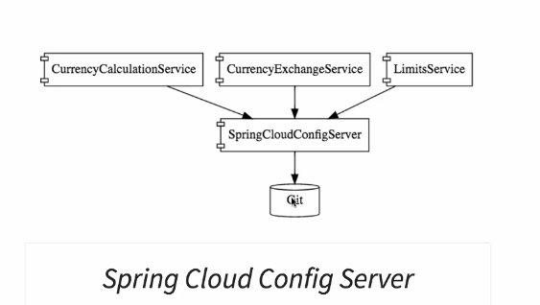
Introduction to spring cloud
Spring Cloud provides tools for developers to quickly build some of the common patterns in distributed systems (e.g. configuration management, service discovery, circuit breakers, intelligent routing, micro-proxy, control bus, one-time tokens, global locks, leadership election, distributed sessions, cluster state). Coordination of distributed systems leads to boiler plate patterns, and using Spring Cloud developers can quickly stand up services and applications that implement those patterns. They will work well in any distributed environment, including the developer’s own laptop, bare metal data centres, and managed platforms such as Cloud Foundry.
- There are multiple projects which provide solution for microservices challenges
Projects from Spring cloud provides solutions to challenges
Configuration management – Spring cloud config server provide environment to store configuration for multiple microservices. This project uses git to store there configuration and expose this configuration for all microservices.

Slide 4
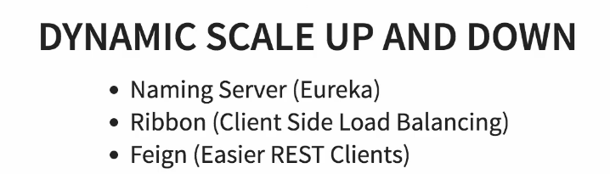
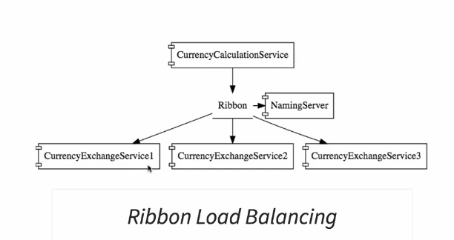
2. Dynamic scale up and scale down
There are different project are used for dynamic scale up and scale down
Naming server- used to register new microservices . Also it maintain the instances for the microservices. Microservices can ask naming server to give current instances of microservices.
Ribbon- ribbon are used to balance load at client side.
Ribbon makes sure the load has been distributed among the all instances of the microservices that gets from naming server.
3. Feign- Are used to create simple RESTfull client.

Slide 5
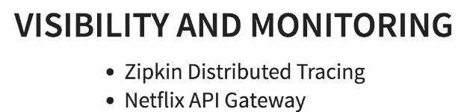

3. Visibility and monitoring
Zipkin distributed tracing- are used to trace requests
We are using spring cloud south to assign id to the request among the multiple component and we are using Zipkin distributed tracing server to trace the request among the multiple component.
2. Netflix API gateway- The multiple microservices can have common features like login, security, analytics.
- We not need to add this common features in all services.
- Netflix API gateway provides great feature to avoid this challenges
- We can use Netflix zuul api getway for this
Fault tolerance
Hystrix- If one of the service has been down hystrix provide default response

Slide 6
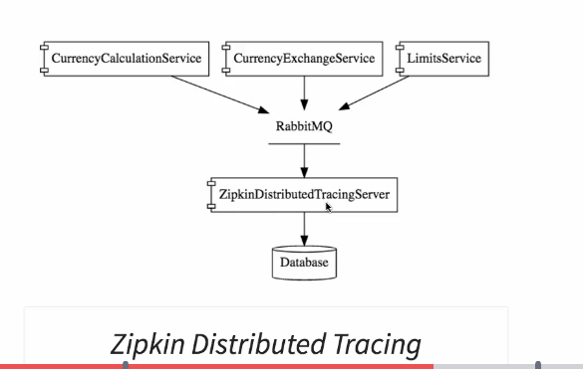
Need to install rabbit MQ
Zipkin distributed server will listning on RabbitMQ server and trace all the log

Slide 7
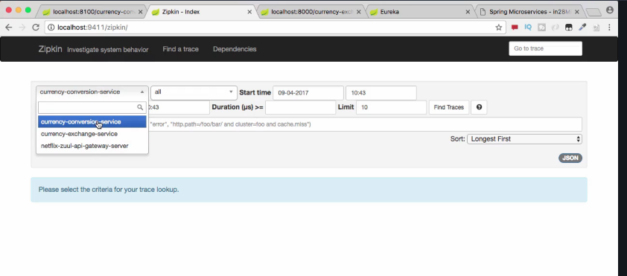
Zipkin UI

Slide 8
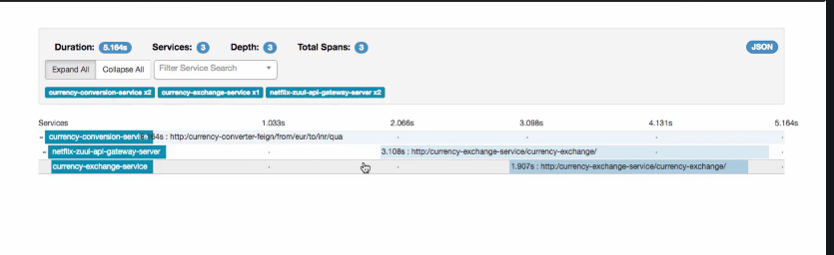
After click on trace it showing the trace of the weservice
Currency conversion service→ Netflix-zuul-api-gateway-server→currency-exchange→ service

Slide 9
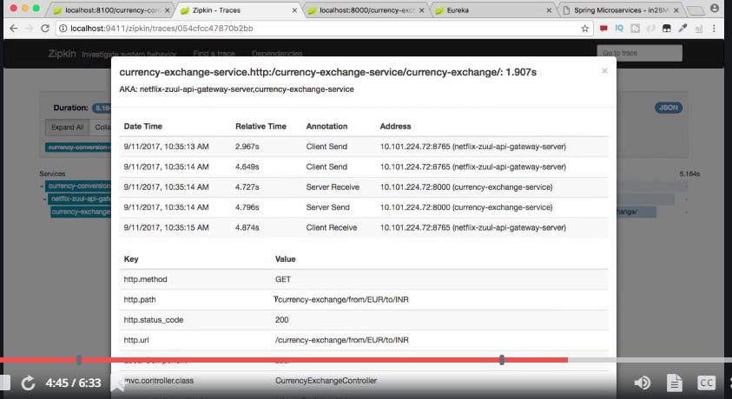
After click on currency exchange service we will get above window
Which contain all the info like status code, url, method

Slide 10
Advantages of microservices architecture
We can easily adopt the changes
We can develop each microservice in different development language
Dynamic Scaling- The load on application would not be same throughout the time. It could be increase and decrease. We can scale up and scale down depend on load on the application

